Slide 1


Forest Fire Detection Using Deep Learning
Name: Ariyan Pujari
Registration ID:STU674931baebbc21732850106

Slide 2

Learning Objectives
Understand CNN architectures Learn dataset preprocessing and augmentation Train a model to detect wildfires from images Evaluate model performance using metrics
Design thinking and Critical thinking
Git and Github
GOAL
Dataset Source: Kaggle (elmadafri/the-wildfire-dataset) Libraries: TensorFlow, Keras, Matplotlib, Pandas
Our goal is to Automatically detect forest fires using image classification via Deep Learning
GitHub: https://github.com/Ariyan9907/fire-detection.git
Source :
www.freepik.com/

Slide 3
Tools and Technology used
Python Utilized as the primary programming language due to its simplicity and rich ecosystem for machine learning and deep learning applications.
TensorFlow & Keras Employed for building and training the Convolutional Neural Network (CNN) model. Keras, with its user-friendly API, allowed rapid prototyping and model experimentation.
Google Colab / Kaggle Notebooks Leveraged cloud-based Jupyter environments for coding, training, and testing the model with GPU acceleration, eliminating the need for local hardware setup.
Convolutional Neural Networks (CNN) Designed the model using layers such as:
Conv2D: For extracting features from input images.
MaxPooling2D: For down-sampling feature maps and reducing dimensionality.
Flatten: To transform the 2D feature maps into a 1D vector.
Dense: Fully connected layers used for final classification of forest fire images.

Slide 4
Methodology
Load and Preprocess Image Dataset Collected and organized the forest fire image dataset, followed by preprocessing steps such as resizing, normalization, and labeling to prepare the data for training.
Create CNN Model Architecture Designed a custom Convolutional Neural Network using TensorFlow & Keras. The model included Conv2D, MaxPooling, Flatten, and Dense layers tailored for efficient image classification.
Train with Data Augmentation Applied data augmentation techniques such as rotation, flipping, and zooming to artificially expand the dataset and improve the model’s ability to generalize to unseen data.
Validate and Test Model Accuracy Evaluated the trained model using a validation set to fine-tune hyperparameters. Finally, tested the model on separate data to assess its performance in accurately detecting forest fires.

Slide 5
Problem Statement:
Forest fires are unpredictable natural disasters that cause extensive damage to ecosystems, biodiversity, and human settlements. Existing detection methods often suffer from delays and limited accuracy due to reliance on manual monitoring and environmental conditions, leading to late interventions and increased risk. Forest fires cause large-scale destruction. Manual detection is slow, subjective, and error-prone. A faster and reliable system is needed

Slide 6
Solution:
An image-based forest fire detection system was developed using a Convolutional Neural Network (CNN) model built with TensorFlow and Keras. The system automatically identifies fire-affected areas in images by learning visual patterns from a labeled dataset. Data augmentation techniques were applied to enhance model robustness, and training was conducted on cloud platforms like Google Colab and Kaggle for efficient computation. The final model provides accurate and real-time predictions, aiding in faster response to forest fire incidents. By classifying images as “Fire” or “No Fire” quickly and accurately Reduces response time and improves monitoring.

Slide 7
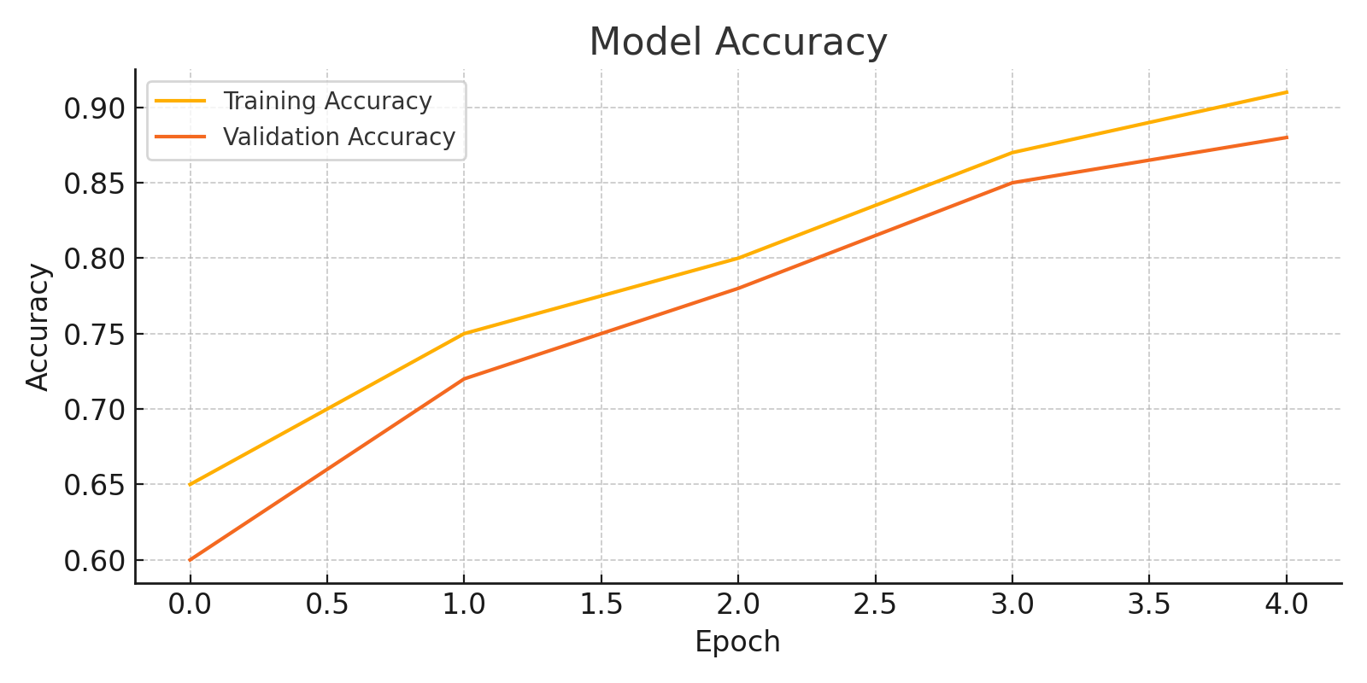
The graph illustrates the training and validation accuracy of the CNN model over 5 epochs. Key observations:
Steady Improvement: Both training and validation accuracy consistently increase with each epoch, indicating effective learning by the model.
Training Accuracy rose from 65% to over 91%, while Validation Accuracy improved from 60% to around 87%.
Small Generalization Gap: The gap between training and validation accuracy is minimal, suggesting that the model is not significantly overfitting and generalizes well to unseen data.
Performance Trend: The upward trend in both curves shows that the model continues to improve with more training and is capable of further optimization with additional epochs or fine-tuning.
This graph confirms the reliability and learning effectiveness of the model in detecting forest fires from image data.

Slide 8
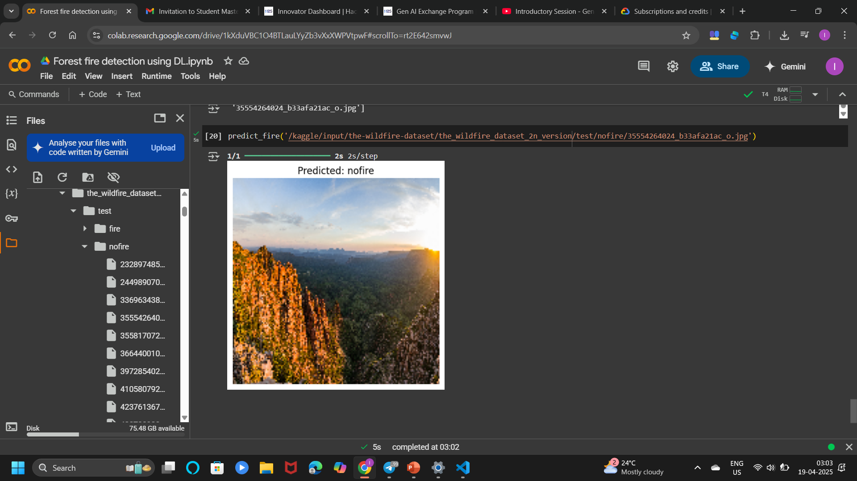
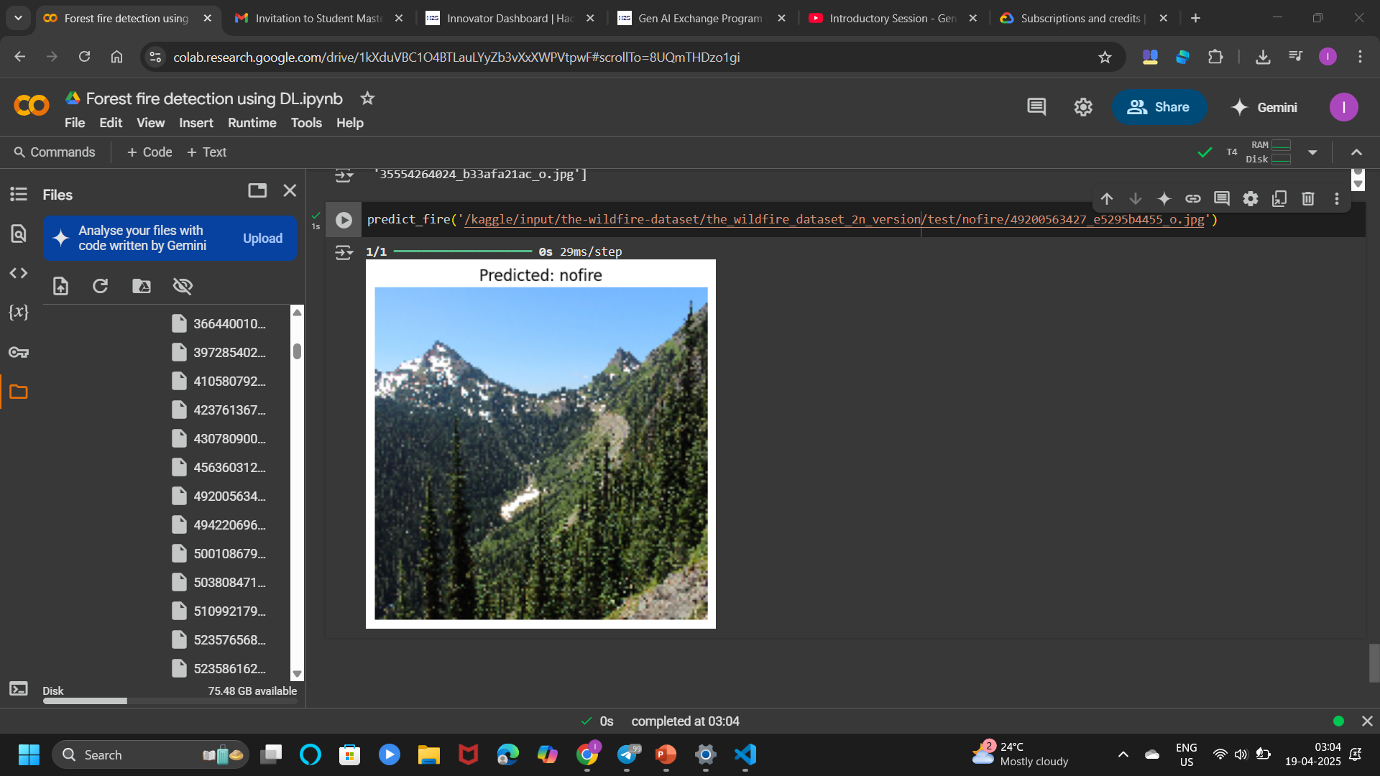
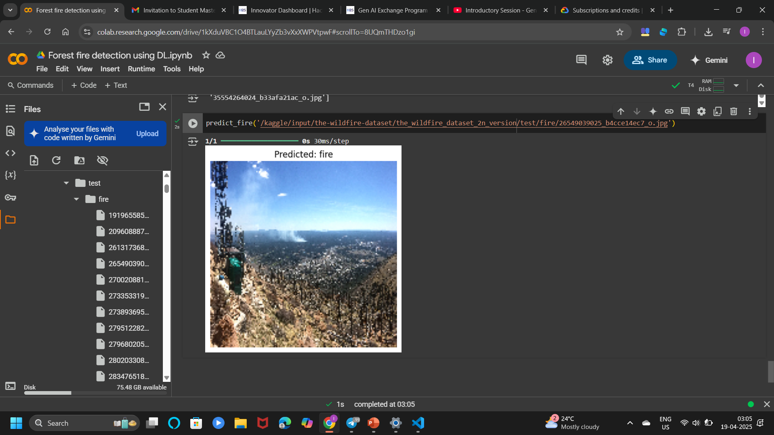
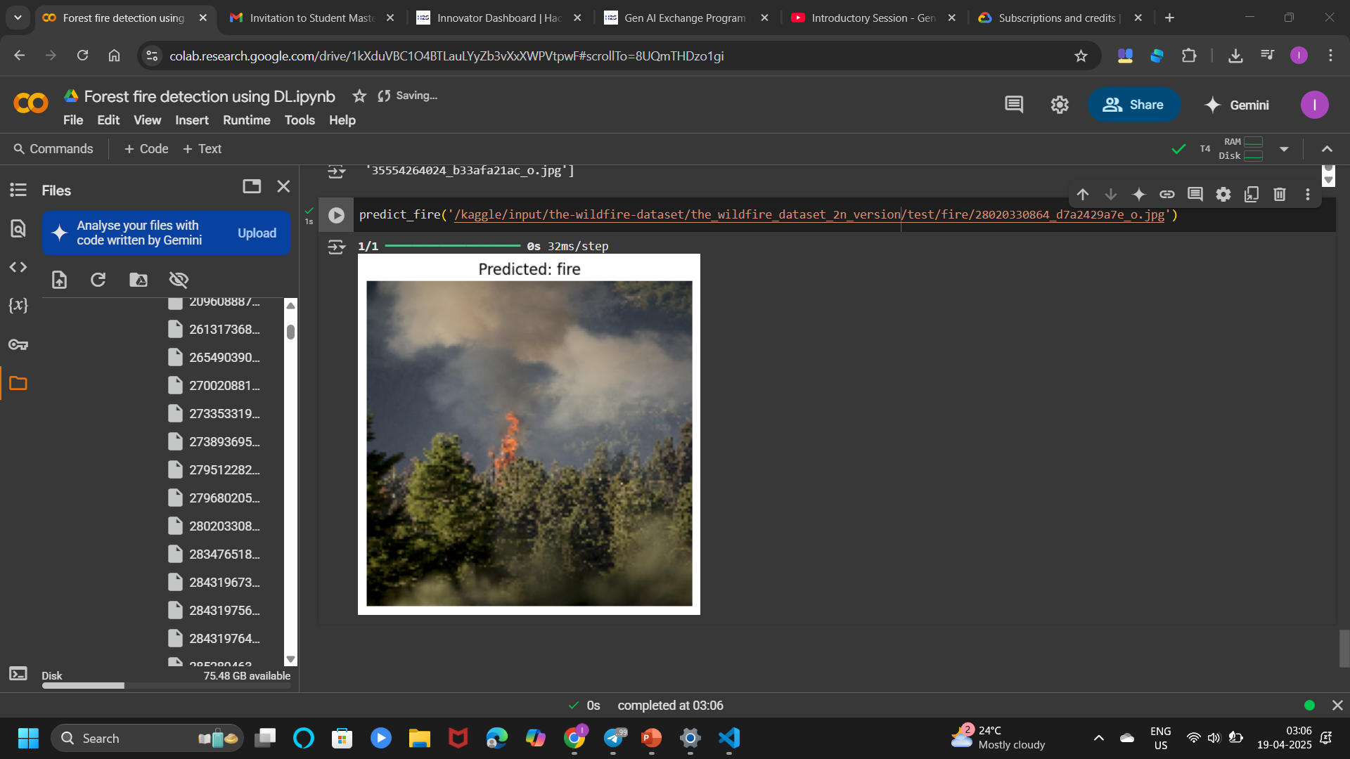
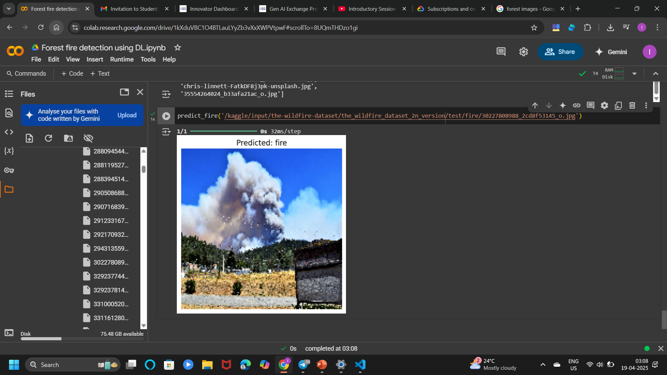

Slide 9
Conclusion:
The forest fire detection system built using deep learning successfully demonstrates the potential of AI in solving real-world environmental challenges. By leveraging Convolutional Neural Networks (CNNs), the model was able to learn complex visual patterns from forest fire images and classify them with notable accuracy. The use of data augmentation improved the model’s generalization, and cloud-based platforms like Google Colab facilitated efficient training and testing.
This project proves that automated, image-based fire detection can serve as a vital tool in early disaster management, offering rapid identification compared to traditional, manual methods. Though currently limited to static image analysis, the model lays a strong foundation for future integration into real-time systems.
The results validate the applicability of deep learning not just in forest fire detection but also in broader environmental monitoring systems. With ongoing improvements and real-world deployment, such solutions could significantly aid authorities in mitigating the devastating impact of wildfires.

Slide 10
Limitations:
Dataset Size & Diversity: The model’s accuracy depends heavily on the quality and variety of training images; limited datasets may reduce performance in real-world scenarios.
False Positives: Smoke, sunlight, or similar textures in images can sometimes trigger incorrect predictions.
No Real-Time Implementation: Current model operates on static images only and is not integrated into a live detection pipeline.
Limited Environmental Context: The system does not consider non-visual indicators like temperature or wind speed, which can affect fire behavior.

Slide 11
Future Scope:
Real-Time Video Detection: Extend the model to process live video streams from drones or surveillance cameras for real-time forest fire monitoring.
Integration with IoT Devices: Combine with sensor networks (temperature, smoke, humidity) for a multi-modal fire detection system.
Deployment as a Web or Mobile App: Develop user-friendly platforms for forest officials and emergency responders.
Scalability to Larger Datasets: Train on larger, diverse datasets to improve accuracy across different forest types and geographical regions.
Early Stage Fire Detection: Enhance sensitivity to detect fires in their earliest visible stages for quicker response.

